Slide 1





HackOrbit 2025
DareDevil

Slide 2


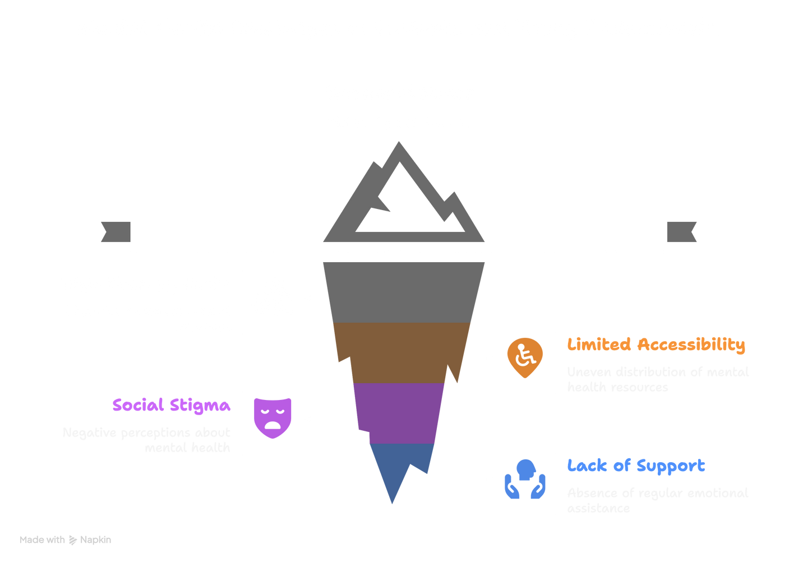

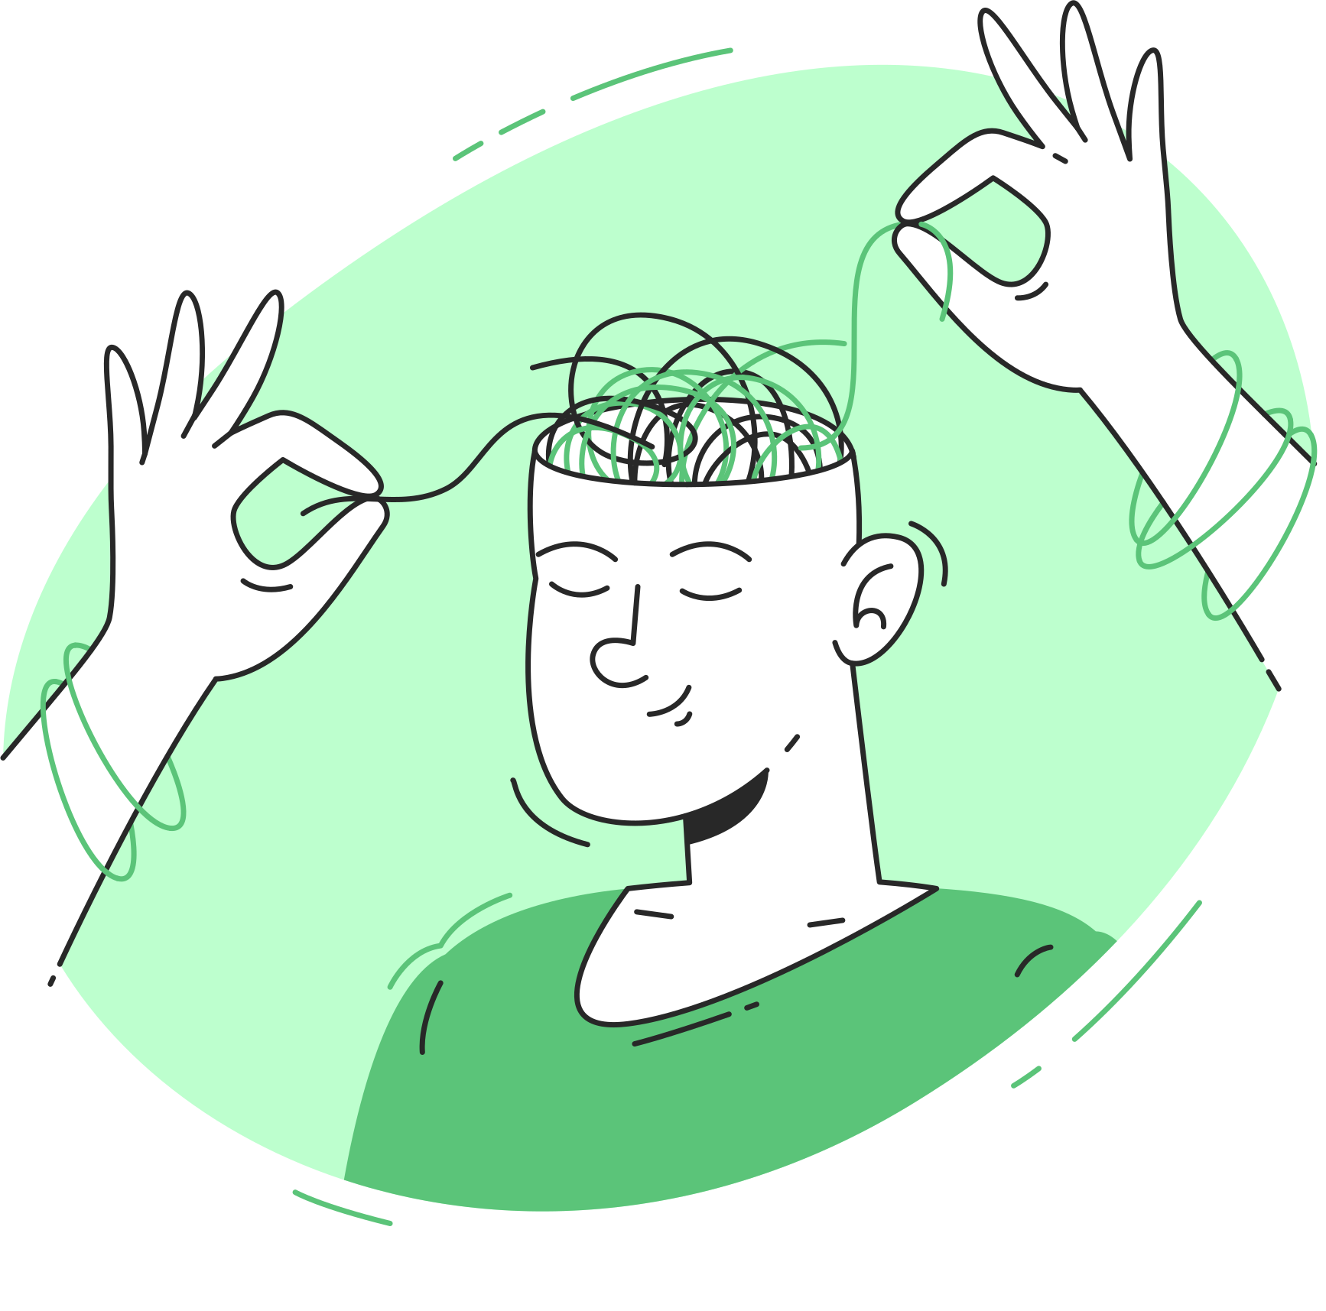
THEME:- HEALTHCARE TECHNOLOGY
PROBLEM STATEMENT
Millions—especially students and young professionals—struggle silently with stress, anxiety, and burnout.

Slide 3
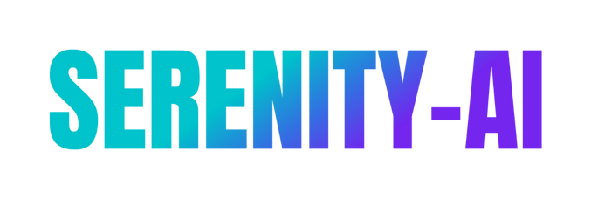



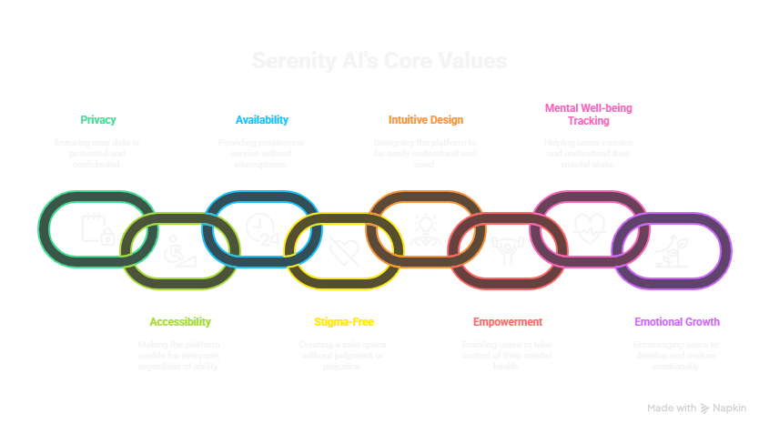
SOLUTION:-
Serenity AI is a SaaS-level, full-stack mental wellness companion conversational webapp
Empathetic chatbot and emotional support
Mood tracking
Guided journaling suggestions
Mindfulness tools and motivational prompt
User Friendly Design
Privacy
Accessibility
Built to be available 24/7
Stigma-free
Beautifully intuitive
Serenity-AI,empowers individuals
To track their mental well-being
Talk it out
Grow emotionally
One check-in at a time

Slide 4
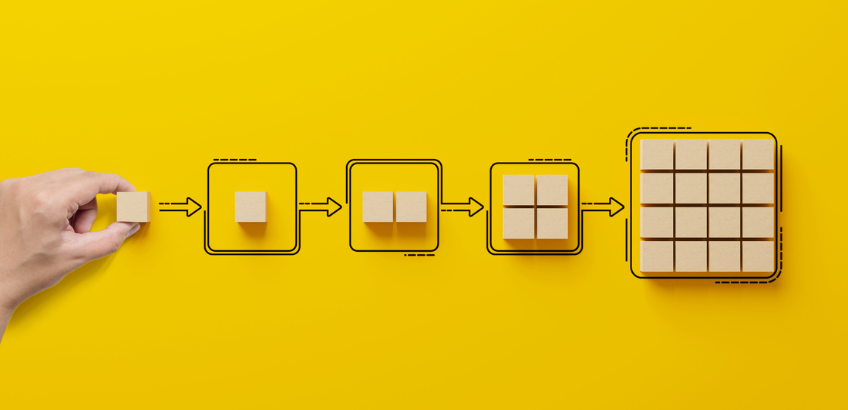

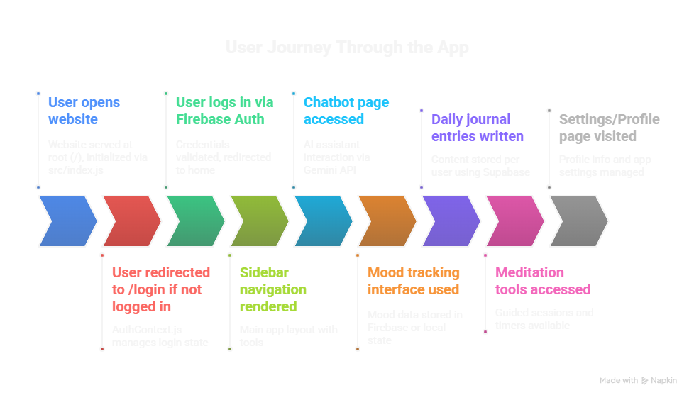
FLOWCHART

Slide 5
FLOWCHART EXPLANATION
1.User opens website
The app is served at root (/) and initialized via src/index.js.
Main layout and routing is handled in App.js.
3. Login/Register Page
Routes to /login or /register.
Uses Firebase Auth to validate credentials.
After successful login, user is redirected to home (/).
5. Chatbot Page (/chat)
Uses an AI assistant (likely using Gemini API via backend).
A chat UI is rendered where user can type and get responses.
7. Daily Journal (/journal)
Lets users write reflections or entries.
Content likely stored per user using Firebase Firestore.
9. Settings/Profile (/settings)
Allows users to update profile info or manage app settings.
2. Authentication Check
Supabase Authentication is integrated.
The app uses a context provider (AuthContext.js) to manage and check login state.
If user is not logged in, they are redirected to /login.
4. Authenticated User Experience
Once logged in, the main app renders:
Sidebar navigation
Different tools via React Router (inside App.js)
6. Mood Tracking (/mood)
A mood selection interface to choose how the user feels.
Possibly stores mood data in Firebase or local state.
8. Meditation Tools (/meditate)
A list of meditation sessions or embedded audio/visual meditations.
May include timers or guided sessions.

Slide 6


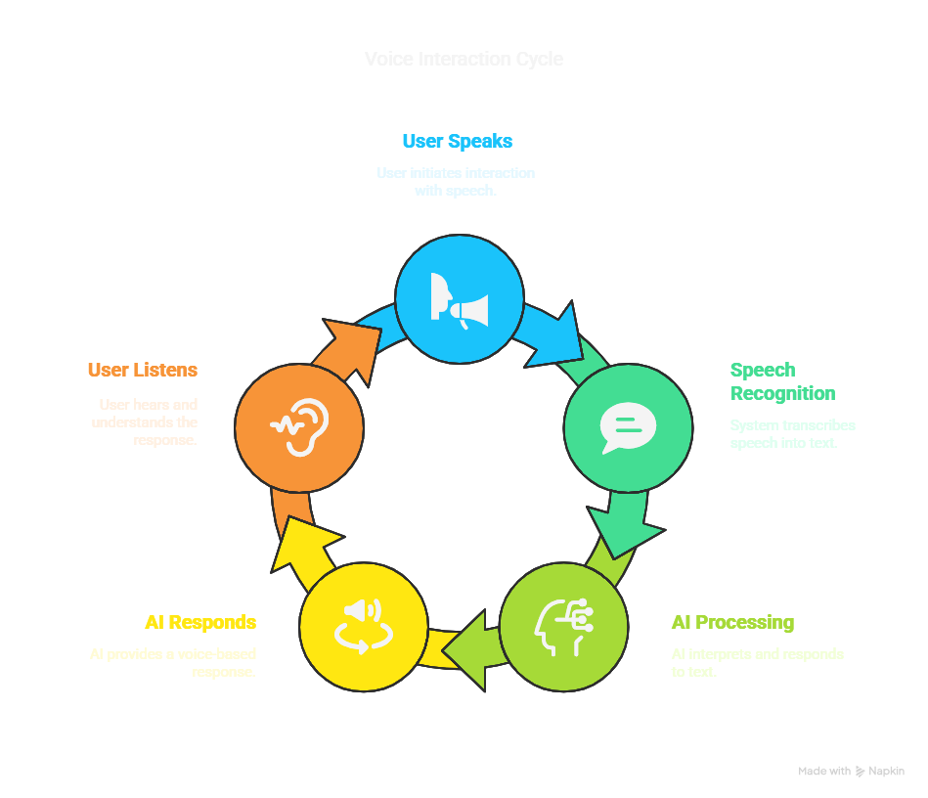

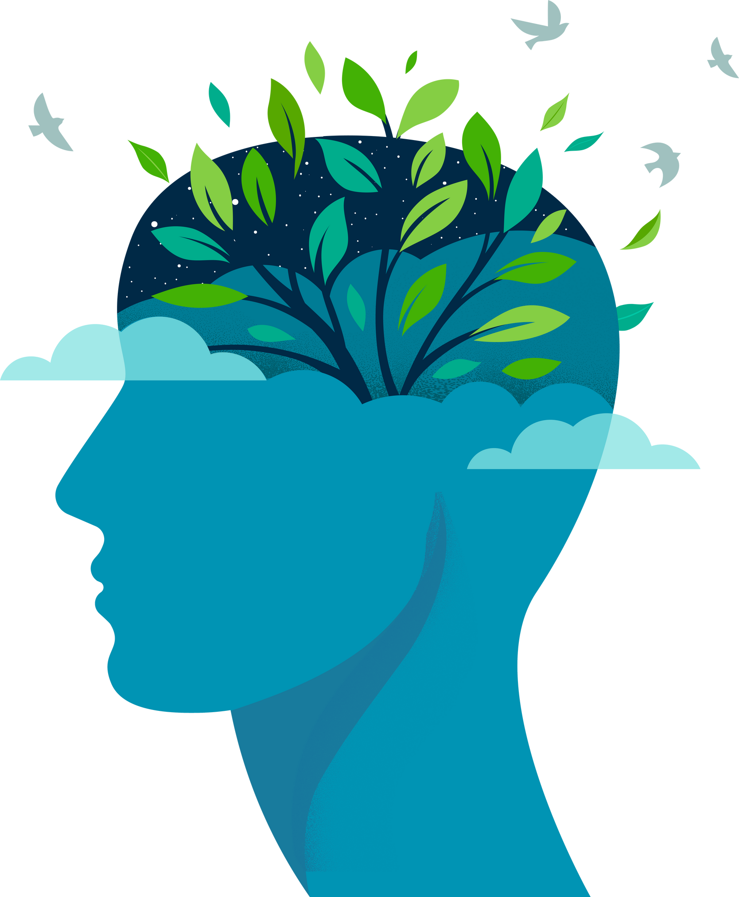
FEATURES AND NOVELTY
AI-Powered Conversations
Advanced NLP with Hugging
Face Transformers
Fallback intelligence
Hybrid AI model: Hugging
Face + HugChat
User Interface (UI/UX)
Built using React + Tailwind CSS
Supports Dark/Light mode
Clean UI with intuitive navigation
System Integration
Cross-platform: macOS,
Windows, Linux
YouTube integration for
relaxation content
Mental Health Features
Daily mood tracking with personalized insights
Guided journaling for emotional reflection
Mindfulness exercises (breathing , grounding)
🎤 Voice Interaction
Real-time speech recognition
Multi-format audio support: WebM, WAV, MP4
Audio conversion via PyDub + FFmpeg
Noise reduction & voice optimization

Slide 7

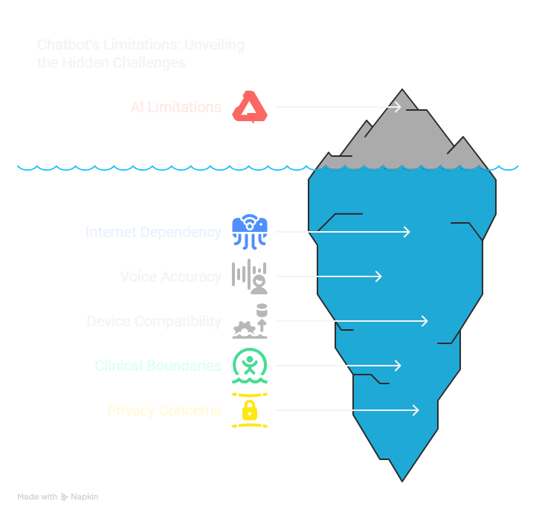
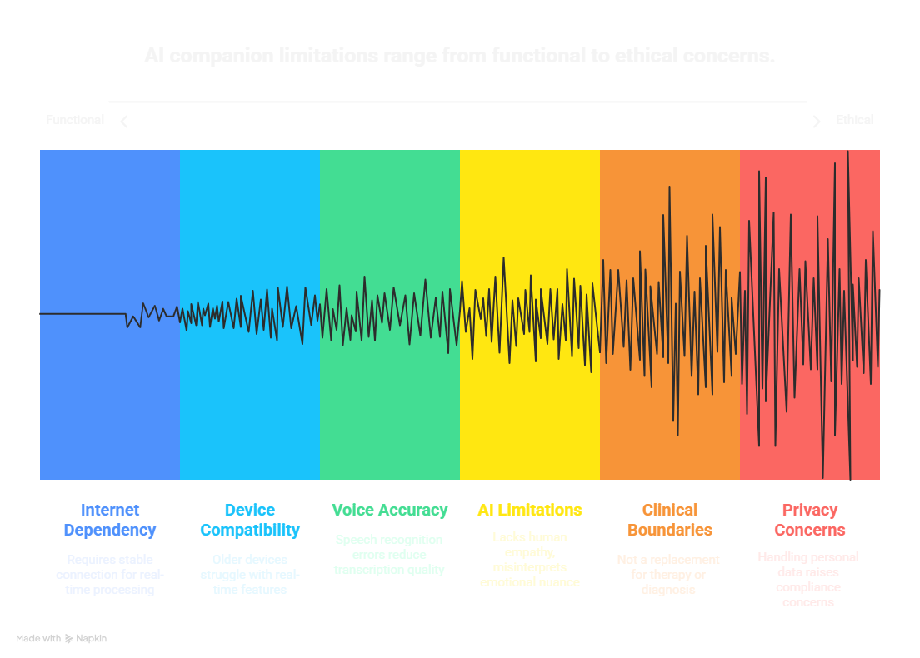
DRAWBACK AND SHOWSTOPPERS

Slide 8


DareDevil
Dhruv Kumar Patel
24cs10dh40@mitsgwl.ac.in
Apoorv Pal
apoorvpal_se24b01_033@dtu.ac.in

Slide 9


